Slide 1
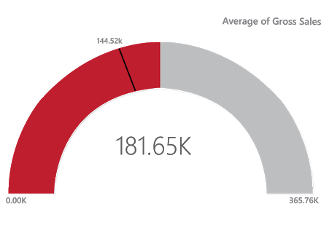
GAUGE CHART
A gauge chart is also known as a speedometer or dial chart. It uses the needle to read the data, and it shows the information on a dial. In the gauge chart, it represents the value of each needle as it reads the data according to the axis or colored data. These charts are useful to compare the values between the variables either by using multiple needles on the same gauge or different gauges. For Instance: The above gauge chart shows you the average gross sales of the company.
.

Slide 2
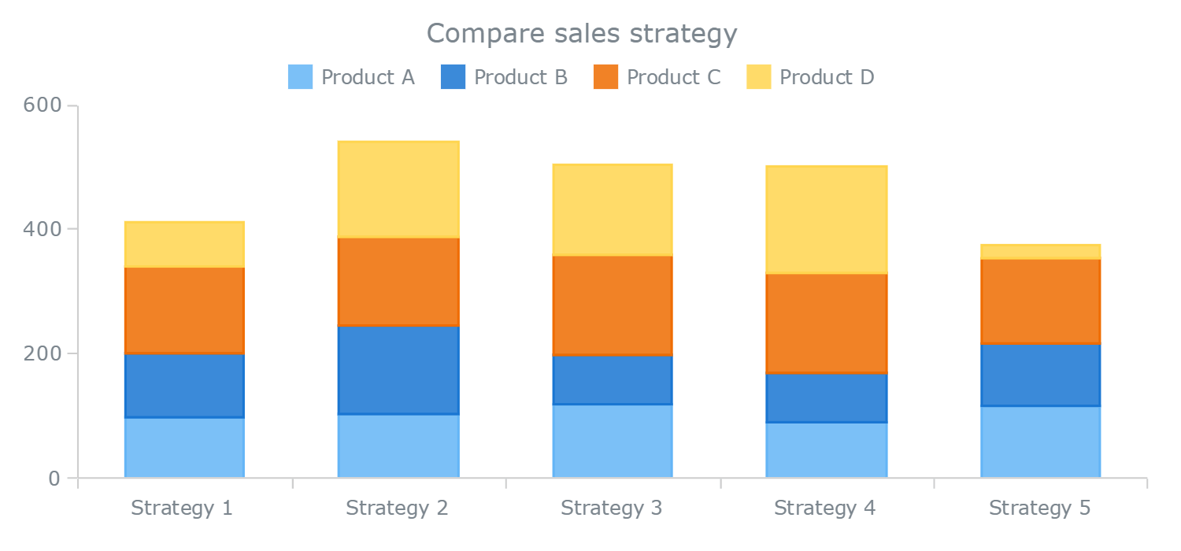
STACKED BAR CHART
Stacked bar graphs are suited for composition breakdowns where you want to examine how data parts make up a whole. Example: components of cost structure.

Slide 3
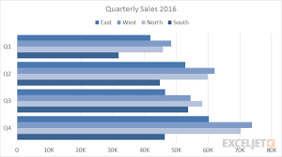
CLUSTERED BAR CHART
A clustered bar chart displays more than one data series in clustered horizontal columns. Each data series shares the same axis labels, so horizontal bars are grouped by category. Clustered bars allow the direct comparison of multiple series in a given category, but it's more difficult for the human eye to compare the same data series across categories.

Slide 4
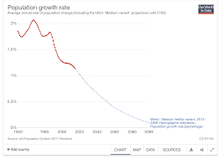
LINE CHART
Line graphs are ideal for making nominal comparisons, showing progress or trends of data over a time series, identifying correlations and deviations, and highlighting relationships between data. Example: company sales.

Slide 5
AREA CHART
This type of chart works well in situations where you want to make comparisons in your data set, identify trends, and show relationships between parts of a whole. Example: trends in multiple data points over time.

Slide 6
COLUMN CHART
This type of graph is well-suited for showing comparisons over time, comparing different products or services, showing the distribution of data, and trend analysis.

Slide 7
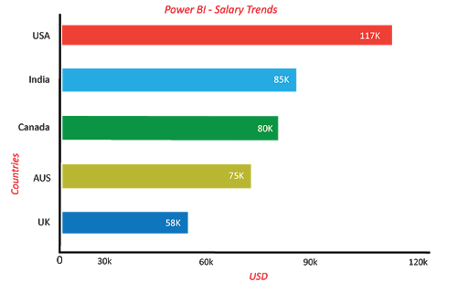
BAR CHART
A bar graph is best used in comparing values, highlighting distribution, ranking data, showing deviations, and comparing smaller data sets (as opposed to large quantities of data).

Slide 8
Pie CHART
Pie charts are useful in demonstrating how individual parts of data make up a whole. Use pie charts to compare percentages, where the sum of the slices equal 100%.

Slide 9
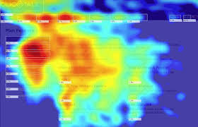
HEATMAP
A heatmap visualization shows the relationship between the two elements and provides rating information. Rating information is displayed using different colors or different saturation. A heatmap is a graphical representation of data that uses a system of color-coding to represent different values

Slide 10
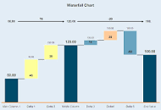
WATERFALL CHART
A waterfall chart is a form of data visualization that helps in understanding the cumulative effect of sequentially introduced positive or negative values. These intermediate values can either be time based or category based.

Slide 11
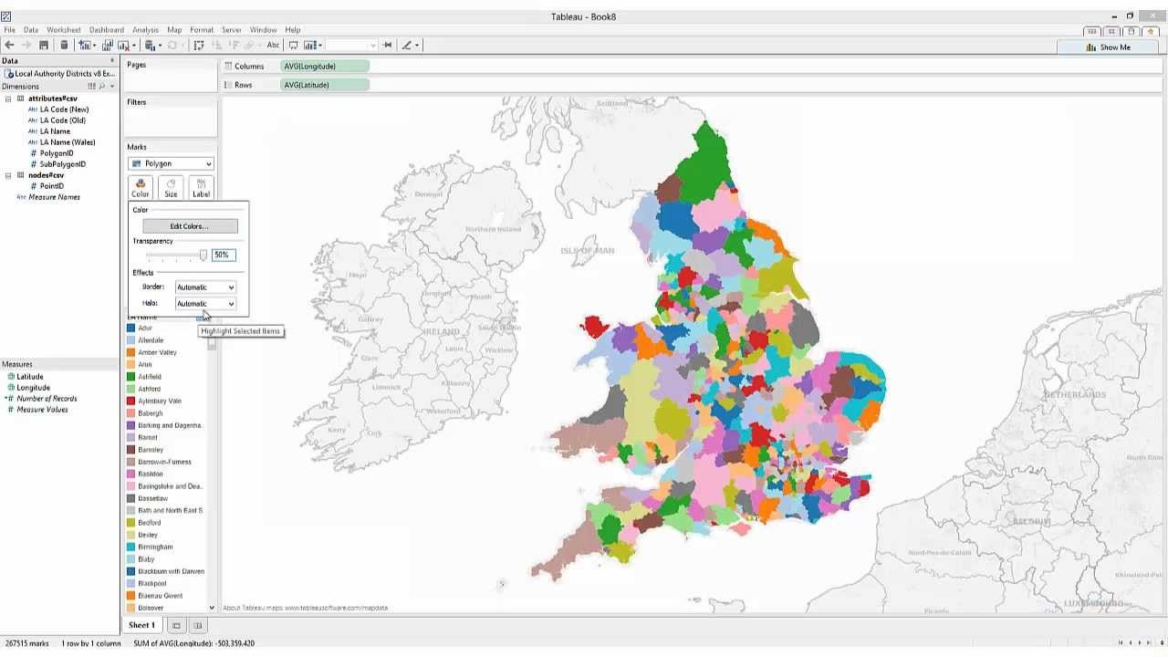
FILLED MAP
Filled Map is a map that shows data points as Geo-spatial areas rather than points on map. Areas can be continent, country, region, state, city, or county. ... You need to set the data category of fields in the data model appropriately to get the Filled Map working correctly.

Slide 12

WORD CLOUD
A word cloud (also called tag cloud or weighted list) is a visual representation of text data. Words are usually single words, and the importance of each is shown with font size or color. Here is an example showing the most frequent words

Slide 13
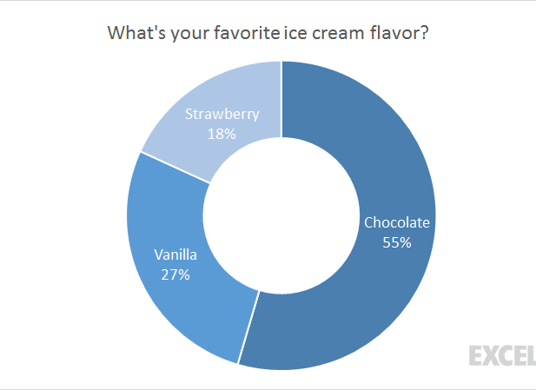
DOUGHNUT CHART
The Doughnut Chart is a built-in chart type in Excel. Doughnut charts are meant to express a "part-to-whole" relationship, where all pieces together represent 100%. Doughnut charts work best to display data with a small number of categories (2-5). For example, you could use a doughnut chart to plot survey questions with a small number of answers, data split by gender, Windows vs. Mac users, or other data where categories are limited.

Slide 14
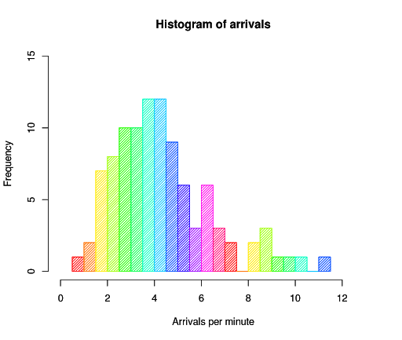
HISTOGRAM
Histogram chart is similar to a column chart, and it visualizes the distribution of data over a certain time. Each bar in the histogram shows the frequency at each interval.

Slide 15
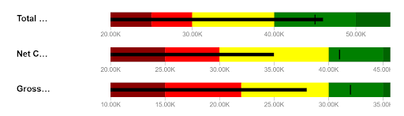
BULLET CHART
Bullet charts are the replacement of dashboard gauges and meters. They are useful to compare one or more measures to enrich the data. Bullet charts may be vertical, horizontal and may be stacked to allow the comparison of the data.

Slide 16
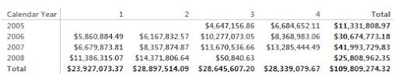
MATRIX CHART
A Matrix chart shows the relation between two or more variables in a data set. It is mainly made up of columns and rows to represent the data in the grid format. At least two variables are required to create a matrix chart if there is any third or fourth variable, and color or other dimensions that can be added to the matrix to represent the data.
For Instance:
The above matrix chart represents the company’s revenue in different years with other factors.

Slide 17
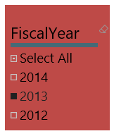
SLICER CHART
Slicers charts are visual filters. Using slicers, you can filter or sort your data by clicking on the type of data you want. In the below example, you can see all-region sales. In case if you want to see particular region sales, then click on that region, and it shows the specific region sales.

Slide 18
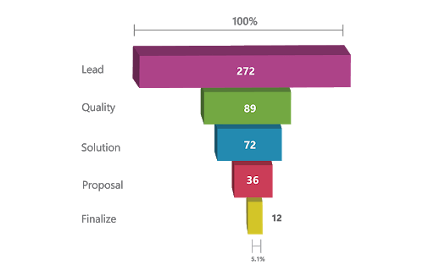
FUNNEL CHART
The funnel chart is a type of chart which is used to visualize the data that flows from one phase to another phase. In the funnel chart, whole data is considered as 100%, and in each phase, it is represented as numerical propositions of the data
For Instance:
Above Funnel charts show the flow of each phase. In the below image you can see the total leads per day is 272, the quality leads are 89, solution leads are 72, proposal leads are 36 and finalize leads are 12

Slide 19
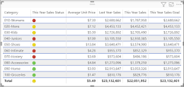
TABLE
A table visualization lets you display data from a metric set using a tabular view. A table is also known as a data grid or data table, and it is the default type of visualization that is used when first selecting data if you did not choose another type.

Slide 20
KPI
KPI is a measurable parameter that demonstrates the level of achievement of a target. What this means is that a metric would translate into a KPI only when it can lead you to concrete actions that can help your organization achieve its broad goals.
For instance, the number of page views on your website is not a KPI because page views do not necessarily have a bearing on your broad goal: ensuring client conversions from website visits. You might have a very high number of visitors on your website but barely any of them converting to actual clients. In this situation, the website visitors to client conversion rate is the right KPI for you.

